Slide 1
UNIVERSITY HOUSING
2021 First-Year Orientation

Slide 2
01
02
03
04
ASSIGNMENTS
RESOURCES
MOVE IN
LIVING ON CAMPUS
Process timeline and room change requests
Find the answers you need once you leave campus
Dates, arrival times, what to expect and more
What to expect and the all-important Community Guide

Slide 3
MISSION
University Housing provides comfortable, affordable and secure on-campus housing options in residential communities where the academic success and personal growth of residents are encouraged and supported.

Slide 4
01
HOUSING ASSIGNMENTS

Slide 5
FIRST YEAR LIVE-0N REQUIREMENT
First-year undergraduate students are required to live in campus residence halls

Slide 6
ASSIGNMENTS TIMELINE
NOVEMBER-MAY
MAY-JUNE
LATE JULY
AUGUST 13-18
Register for housing
Appointment times to choose
a space
Roommate information confirmed
Move in

Slide 7
02
RESOURCES

Slide 8
ONLINE RESOURCES
NEW STUDENT HUB
WEEKLY WEBINARS
YOUTUBE
Everything you need, all in one place
Tuesdays
@ 7 p.m.
June 8-August 10
Housing 101
Day in the Life
360-degree video tours

Slide 9
OTHER RESOURCES
CALL
BULLDOG FRIENDS + FAMILIES
AREA OFFICE
CHAT
Monday-Friday
8 a.m.-5 p.m.
706-542-1421
Didn’t get one or lost it? Download the PDF
Call for details specific to your building
housing.uga.edu

Slide 10
03
MOVE IN

Slide 11
Move in for fall 2021 is 8 a.m. Friday, August 13 until 9 a.m. Wednesday, August 18

Slide 12
MOVE-IN TIMELINE
AUGUST 13
AUGUST 14-15
AUGUST 16-18
AUGUST 18
Sorority recruitment move in. Arrival times required
Arrival times required
No arrival time required; move in 24/7
First day of class; check in by 9 a.m.

Slide 13
ARRIVAL TIMES
DO I NEED TO SCHEDULE
AN ARRIVAL TIME?
YES
NO
Sorority recruitment participants
Planning to move in August 13-15
Planning to move in anytime August 16 until 9 a.m. August 18

Slide 14
PARKING
CHECK IN
1-hour unloading zones will be in effect August 13-15
After 1 hour, move your vehicle to a long-term lot
Only students can check in. Have your UGA OneCard ready
Once you have your UGA OneCard,
set up your PIN

Slide 15
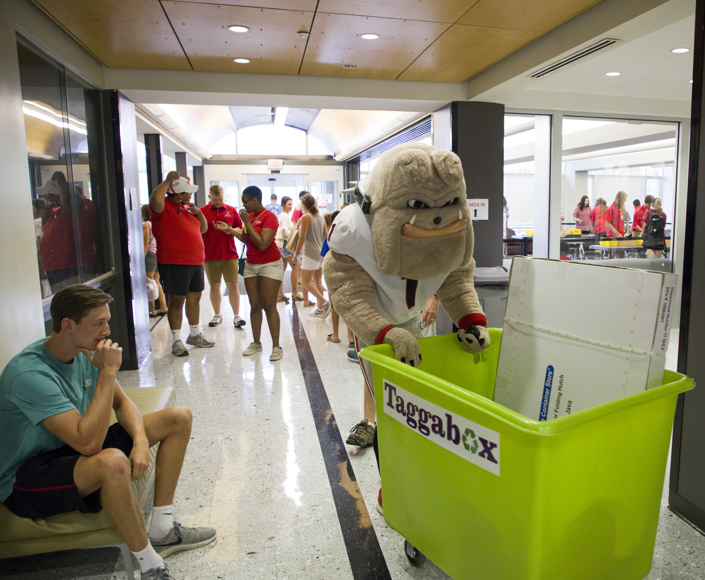
WHAT TO EXPECT
Traffic Some elevator lines Cart checkout available Volunteers Recycling collection Dining halls open

Slide 16
04
COMMUNITY GUIDE

Slide 17
The online Community Guide details housing policies and expectations for residents

Slide 18
Abiding by the policies in the Community Guide is part of the residence hall contract

Slide 19
Imagine yourself a year or two (or three or four) from now….

Slide 20
THANKS!
Questions?
706-542-1421
housing@uga.edu

