Slide 1
CA-RA Team Selection Process
2021-2022

Slide 2
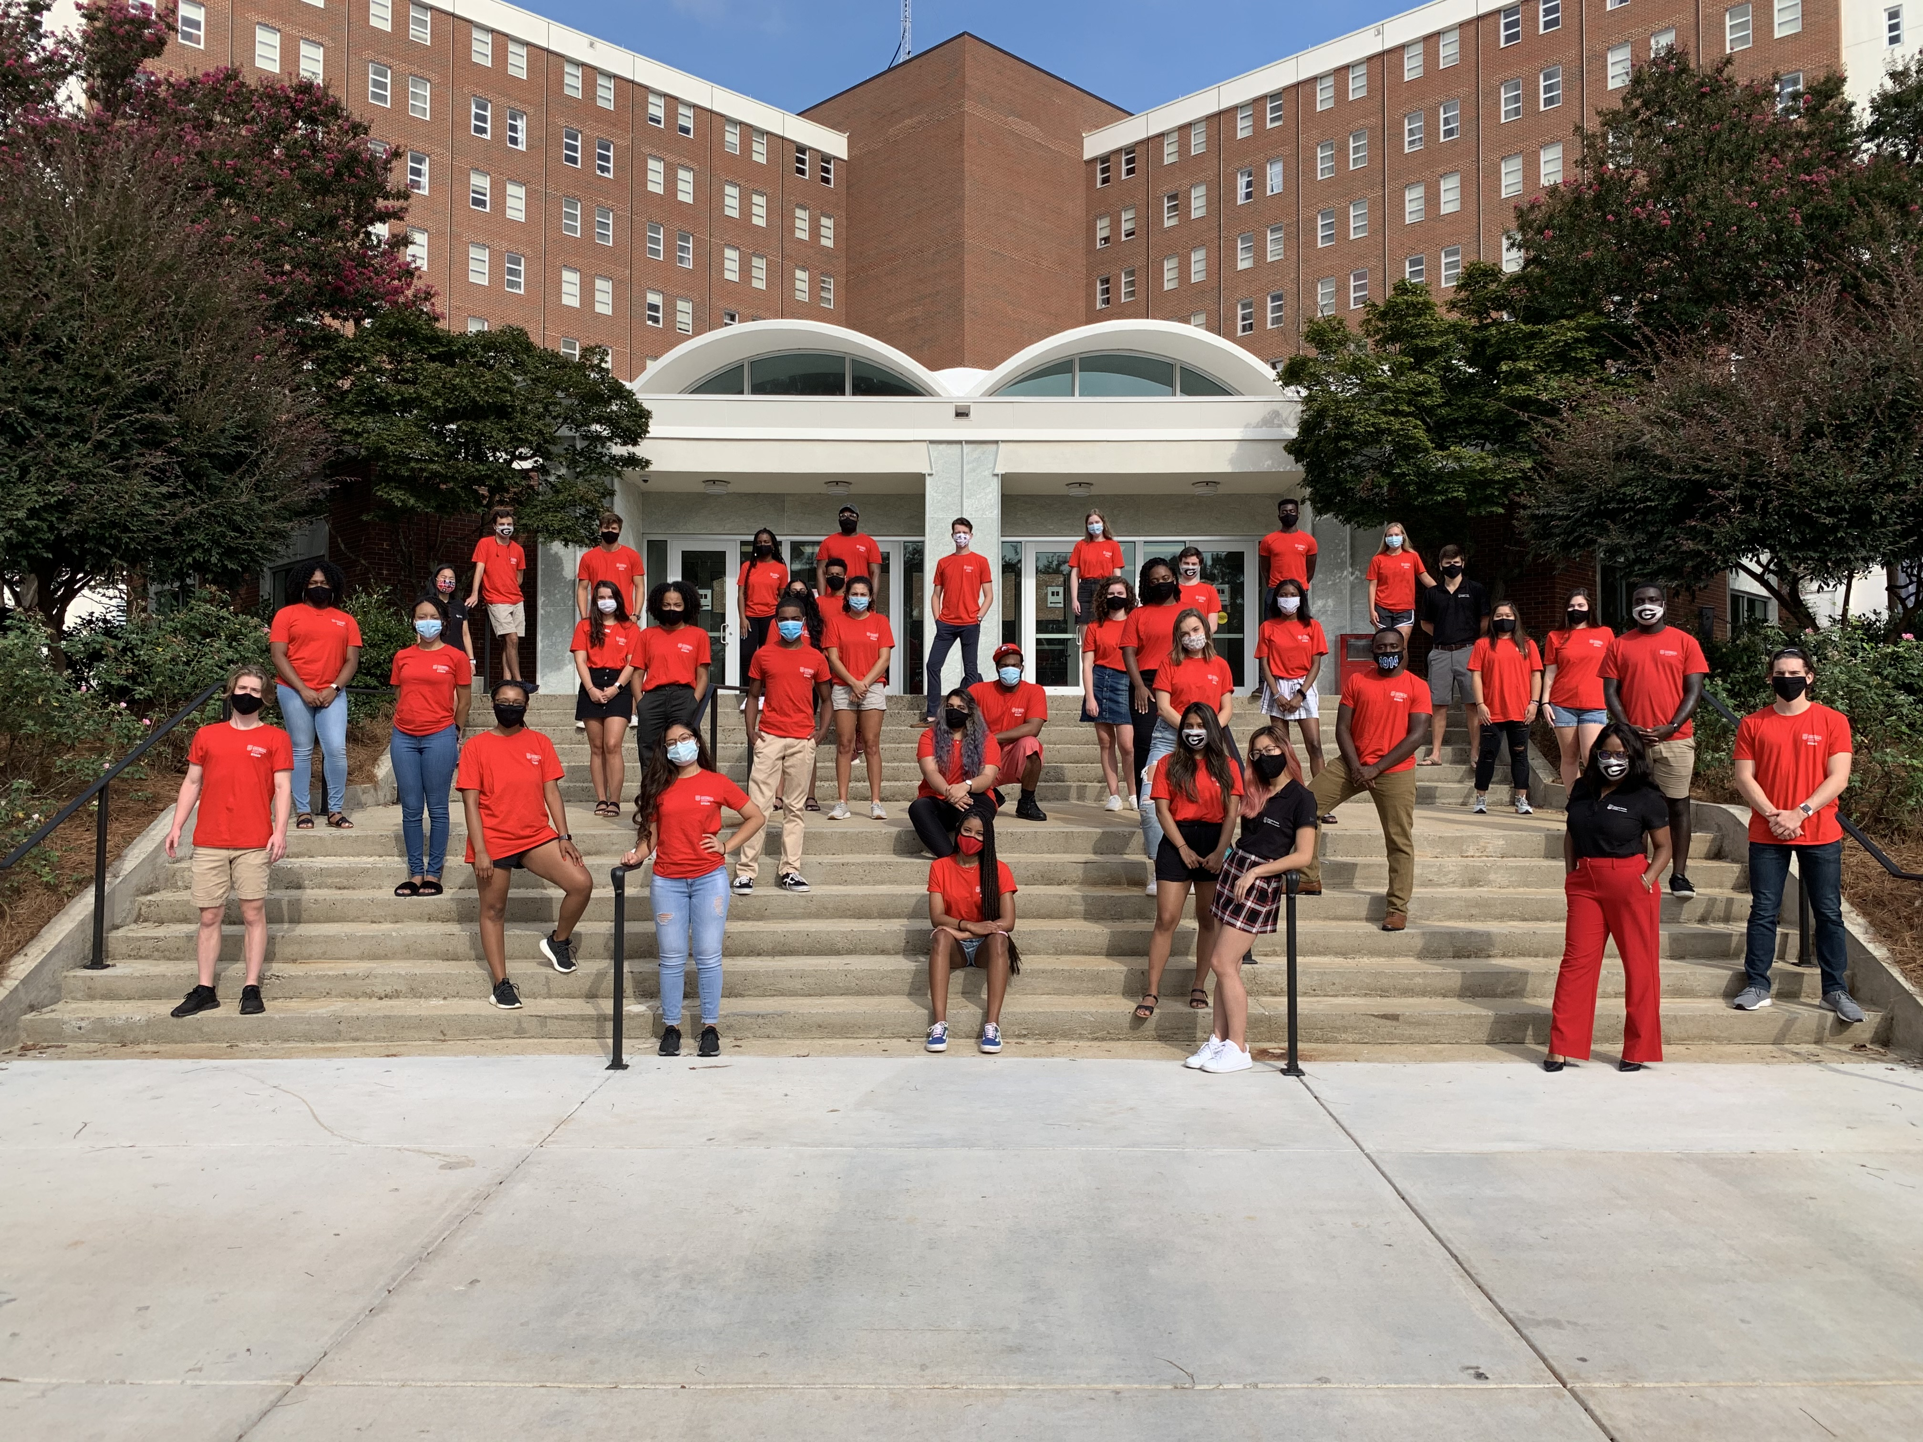
Overview
Mission statement
Overview of positions
- Position descriptions
- Position compensation
What are we looking for?
Overview of selection process
- Application process
- Application review
- Disclosure of employment form
- Interviews
Final Selection
Returning resident room sign-up
CA-RA panel
www.housing.uga.edu

Slide 3
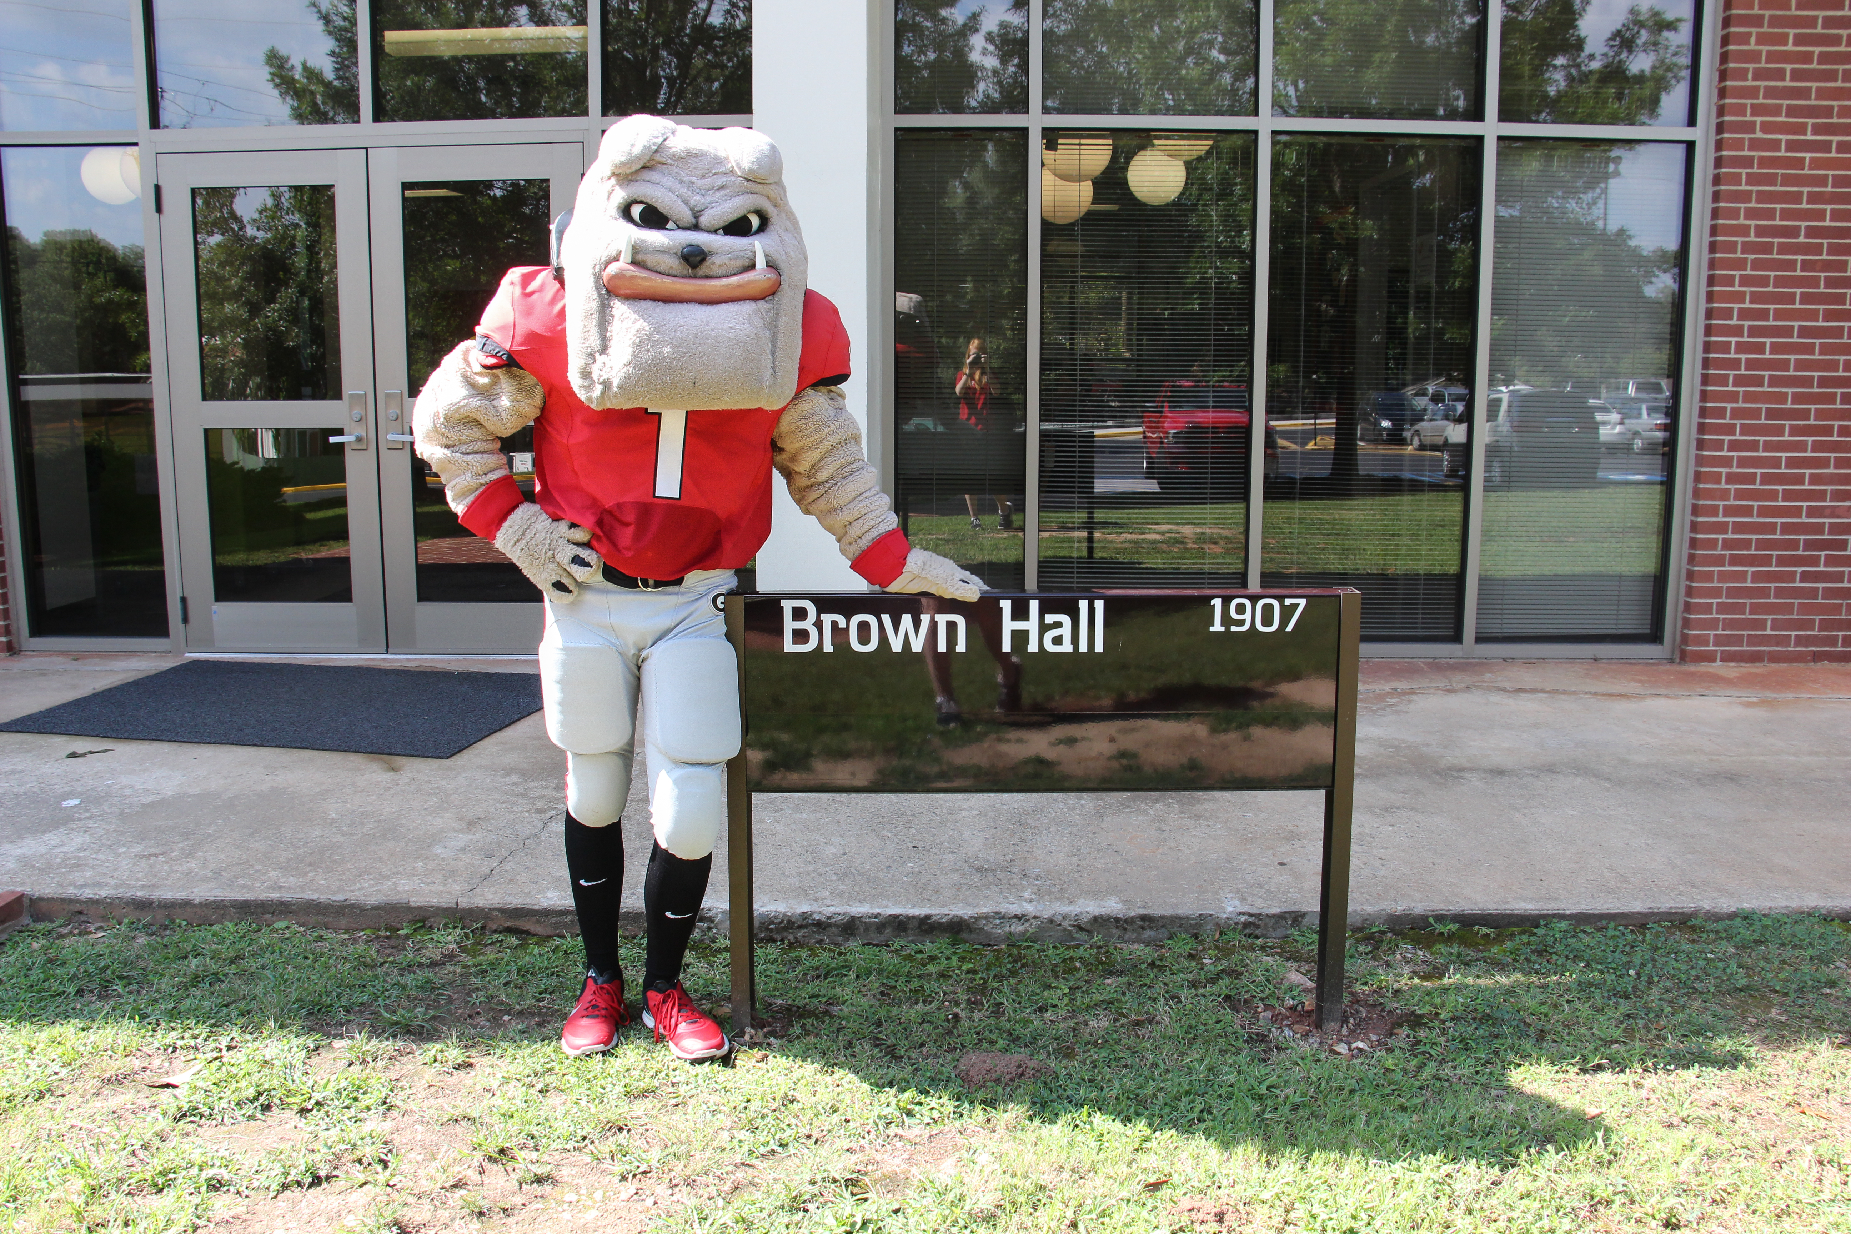
University Housing Mission Statement
University Housing provides comfortable, affordable, and secure on campus housing options in residential communities where the academic success and personal growth of residents is encouraged and supported.
www.housing.uga.edu

Slide 4
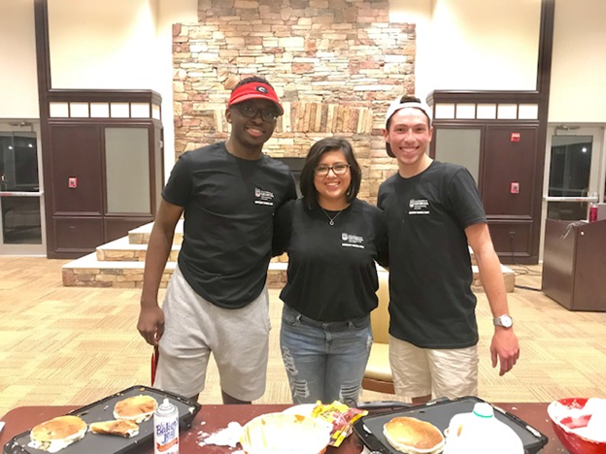
C.L.A.S.S. Advocates (CA)
Continuing the Legacy of African- American Student Success
CAs create a sense of community amongst a diverse group of residents.
CAs work to enrich the experience of African- American students.
CAs engage residents who are interested in multiculturalism, diversity, inclusion, and social justice – all topics around which CAs program.
CAs work toward promoting multicultural understanding among all students on campus.
www.housing.uga.edu

Slide 5
CA Position Responsibilities
Resident Engagement
Maintain weekly interactions with residents and be accessible to residents throughout the week
Interpersonal Skills
Mediate mild-moderate conflict among residents
Intercultural Proficiency and Support
Promote sensitivity for and appreciation of differing perspectives and identities
Leadership Development
Contribute to an atmosphere of teamwork among fellow team members through delegation and mentorship
Serve as a role model
www.housing.uga.edu

Slide 6
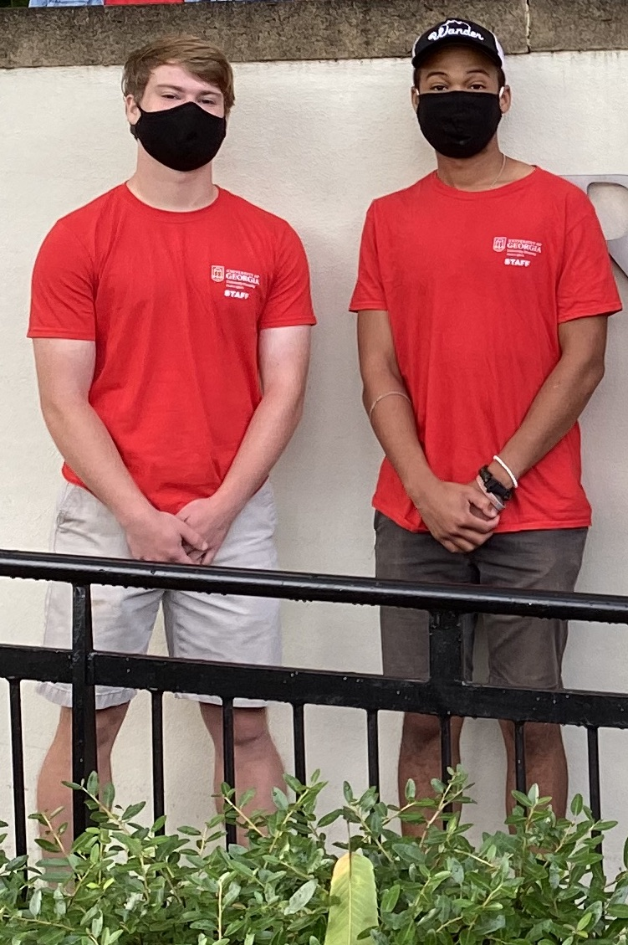
Resident Assistants (RA)
RAs live and interact with a group of 30-75 students in a residence hall community.
RAs promote community building and encourage academic success among residents.
RAs educate residents about campus resources.
RA responsibilities include student engagement, individual interactions, crisis management, programming and nighttime duty, and administrative tasks.
www.housing.uga.edu

Slide 7
RA Position Responsibilities
Resident Engagement
Maintain weekly interactions with residents and be accessible to residents throughout the week
Crisis Management
Provide leadership and model appropriate behavior in a crisis situation
Confront disruptive behavior and policy violations
Administrative Skills
Complete tasks thoroughly, document incidents, report facility concerns, complete health and safety inspections
Interpersonal Skills
Mediate mild-moderate conflict among residents
Intentional and consistent resident conversations
Intercultural Proficiency and Support
Promote a sensitivity for and appreciation of differing perspectives and identities
www.housing.uga.edu

Slide 8
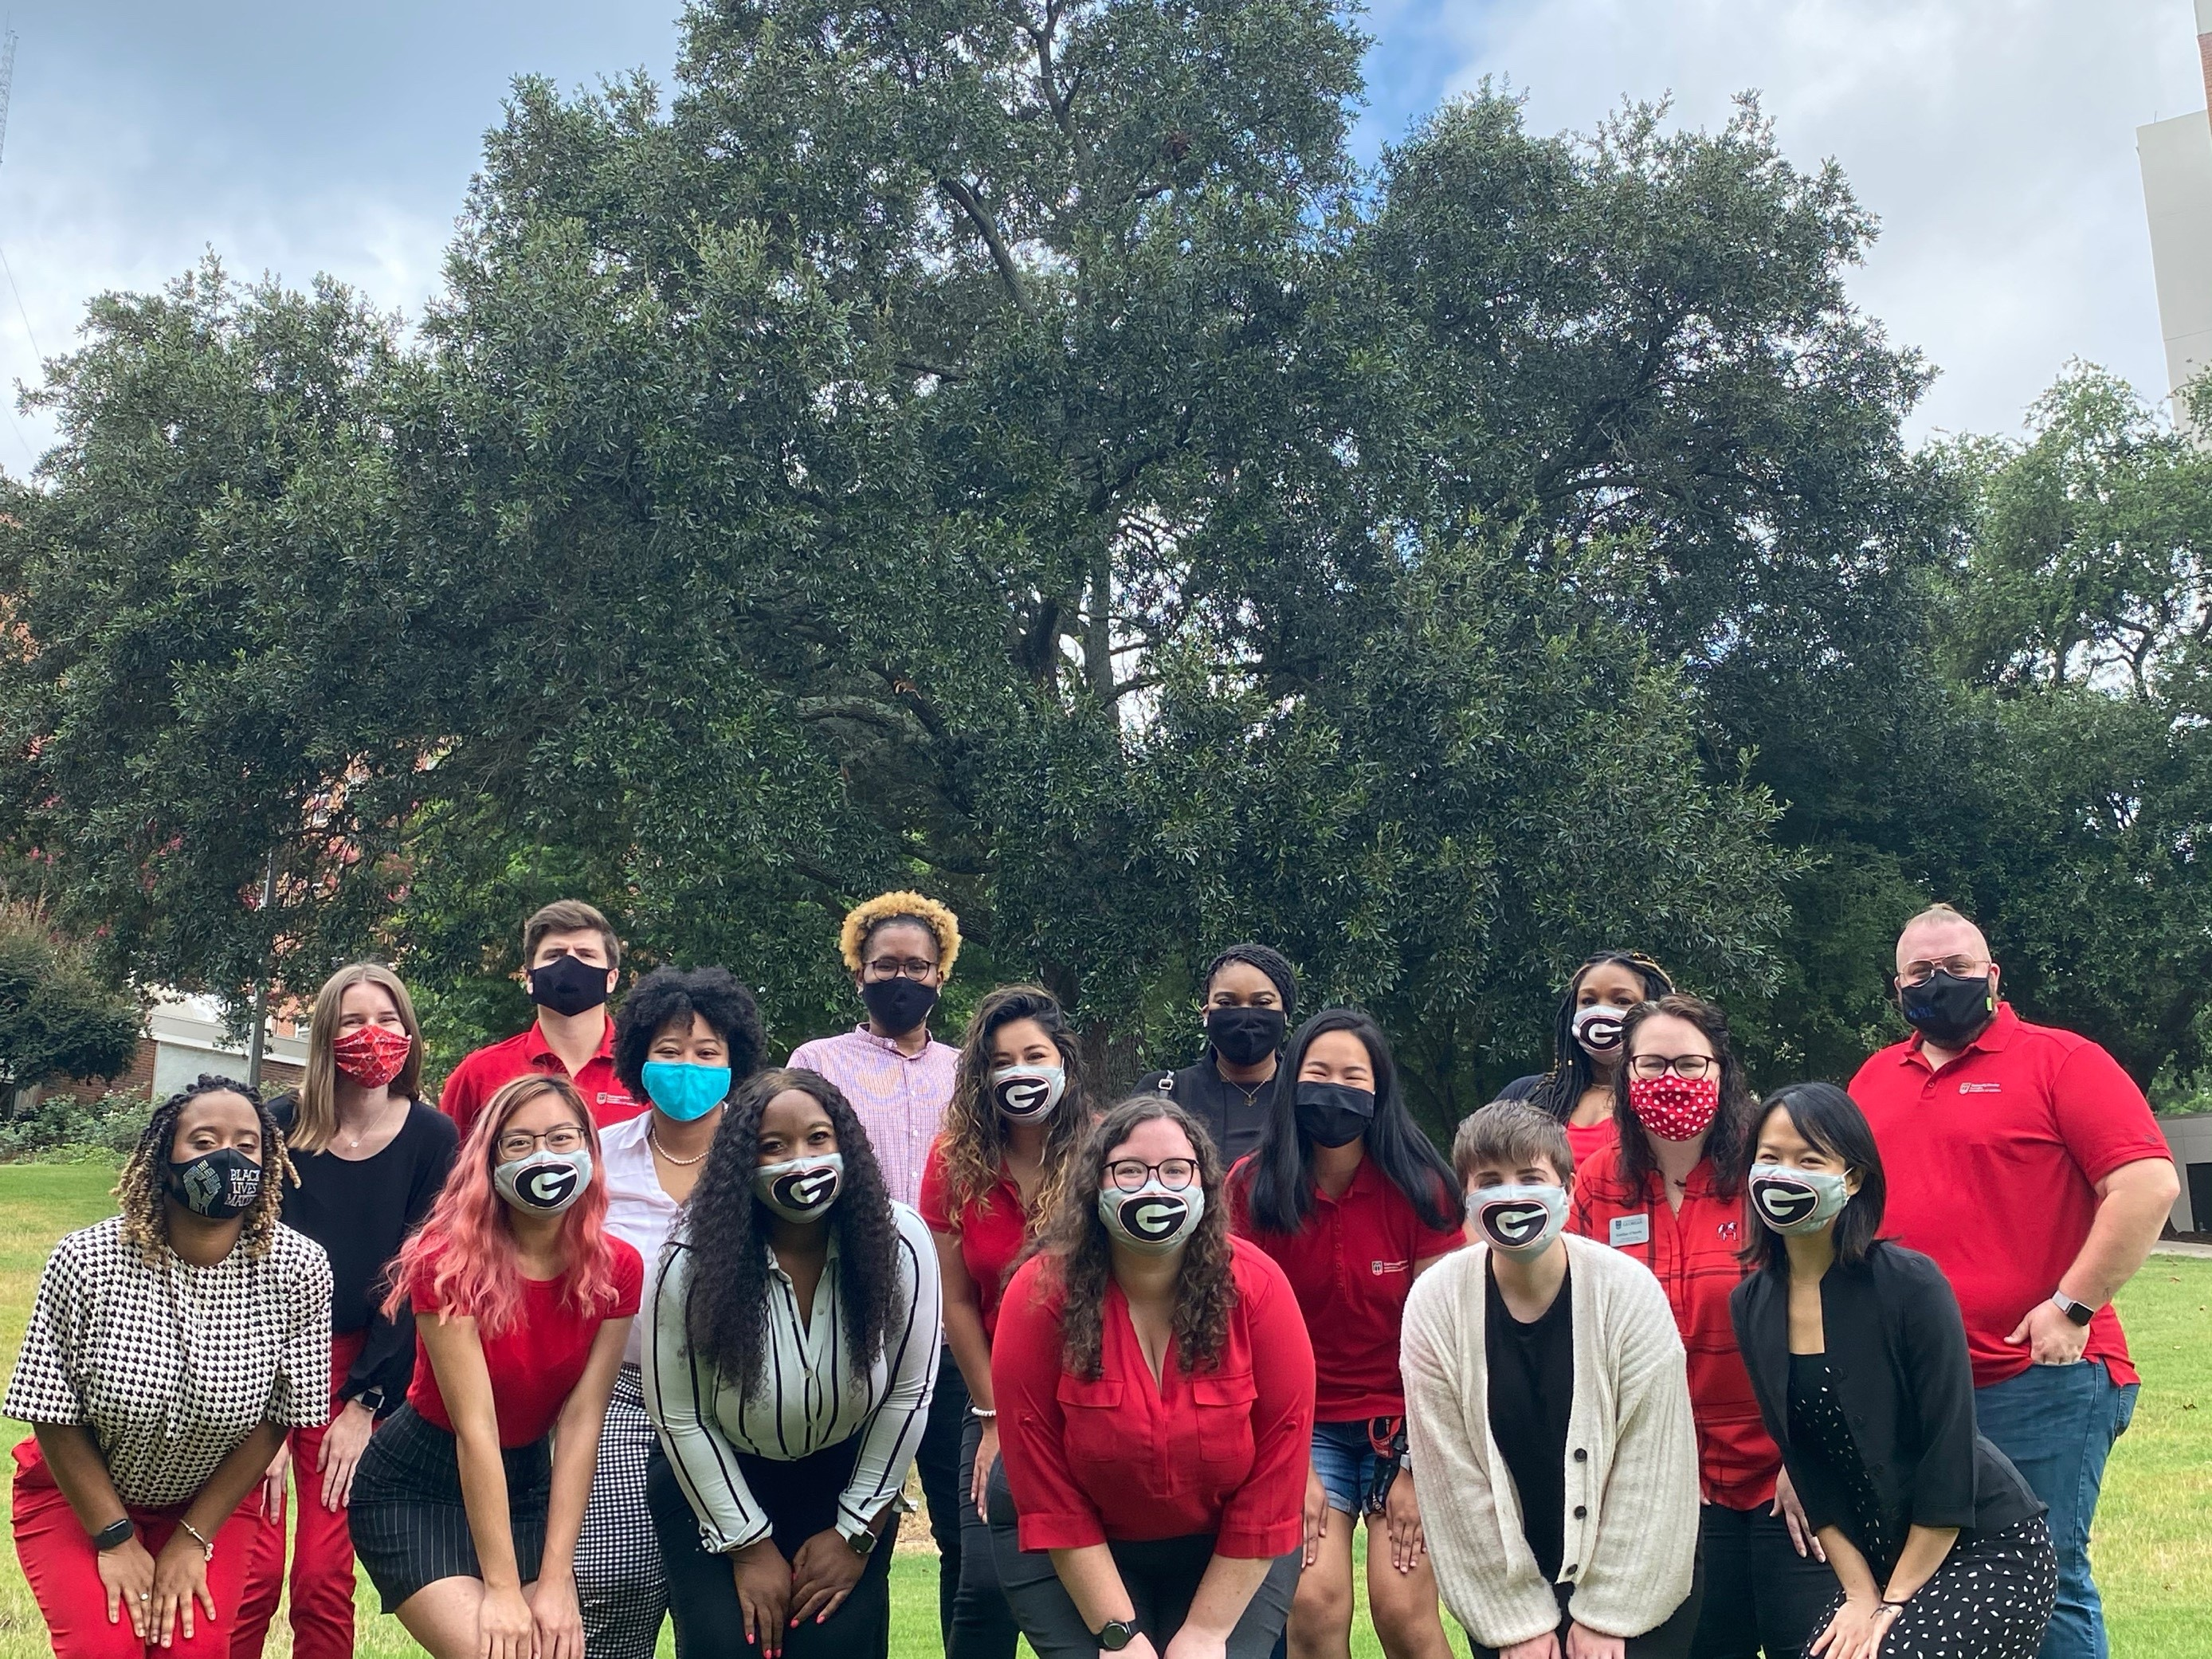
CA-RA Positions
Residents
RAs: residents based upon location (i.e., floor, wing, hall)
CAs: focus on all residents in a community
Break coverage
ECV, Reed, UV, and HSC communities are open year round, so staff are expected to provide duty coverage.
Duty
RAs: rounds are primarily policy and facility related
CAs: rounds on primarily mentoring, 1-on-1 interactions, and social
Know and follow UGA and Housing policies
www.housing.uga.edu

Slide 9
Position Compensation
Private room in Brumby, Creswell, ECV:1516, Hill, Myers, Reed, Russell and HSC Communities
ECV (excluding 1516) RAs share a 2 bedroom, 1 bathroom apartment with another RA
UV – 1 bedroom apartment
Monthly Stipend + Housing Meal Plan
This academic year = $2157 stipend + 105 Access Plan, + $110 PAW Points ($2170 Value)
CA and RAs may not work any other jobs, including note-taking and paid leadership positions on campus
www.housing.uga.edu

Slide 10
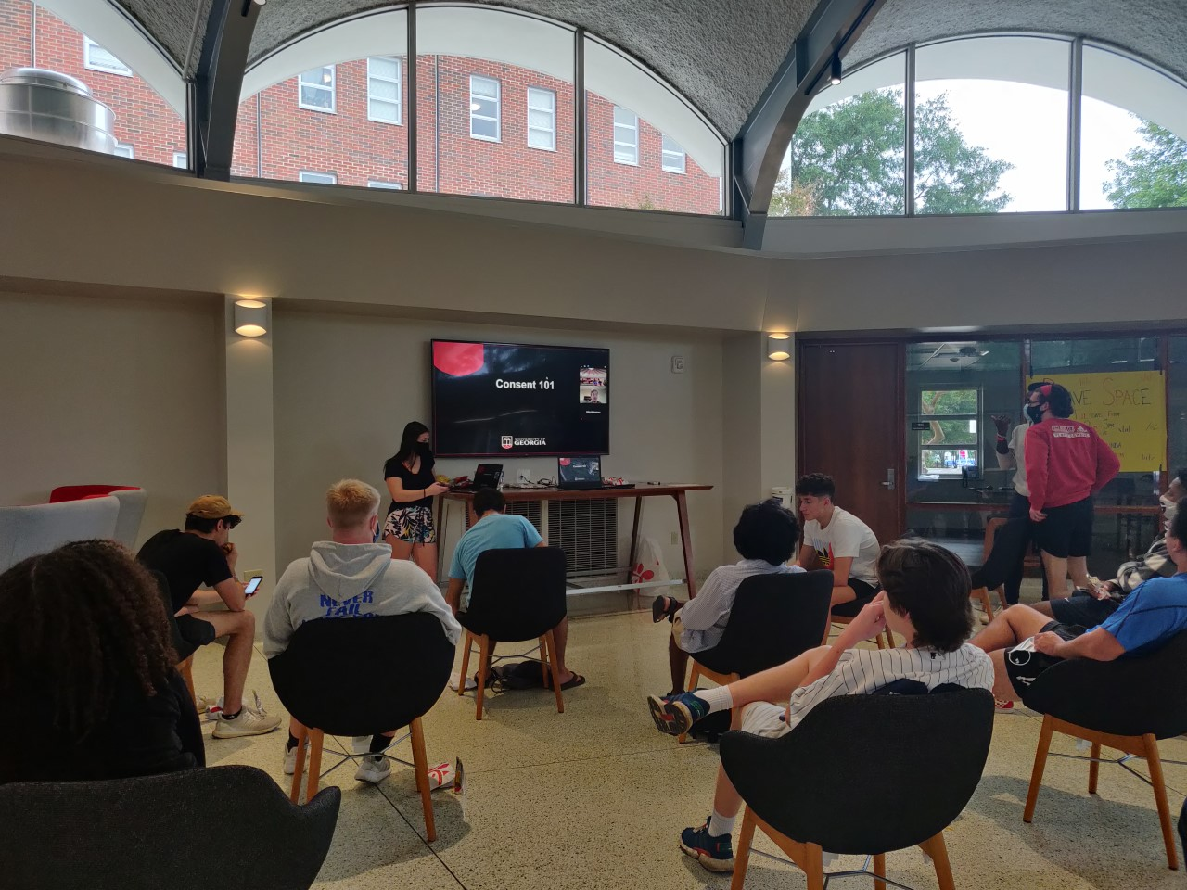
What are we looking for? Potential!
Professional and effective communication skills
Ability to engage with a variety of people
Ability to manage conflict, build rapport, and demonstrate an understanding of social awareness
Strong administrative skills
Responsible and dependable
Good work ethic
Time management skills
www.housing.uga.edu

Slide 11
Application Open Ended Questions
The answers to these questions become a part of your application packet. Supervisors review these answers as they select candidates for position offers.
Why do you want to work for University Housing as a CA or RA?
What skills would you bring to the CA or RA position?
Describe your leadership, work and/or volunteer experience.
What impact does the CA or RA position have on students’ residential experience and how do residents benefit from it?
Have you worked before in University Housing? If so, what skills and/or experiences did you gain that can be applied to this position?
www.housing.uga.edu

Slide 12
References
All applicants for the CA and RA positions will need to have 2 references complete our reference form by December 17, 2020.
The link to the reference form is found on the Housing student employment webpage: bit.ly/studentstaffUGA.
Please share the link with 2 people who can speak to your leadership, work, volunteer and/or academic experience.
References are not required to work
at the university
www.housing.uga.edu

Slide 13
Applications
All links to information sessions, applications, reference forms can be found on our student employment landing webpage:
bit.ly/work4housing
Applications close Thursday, December 17, 2020
www.housing.uga.edu

Slide 14
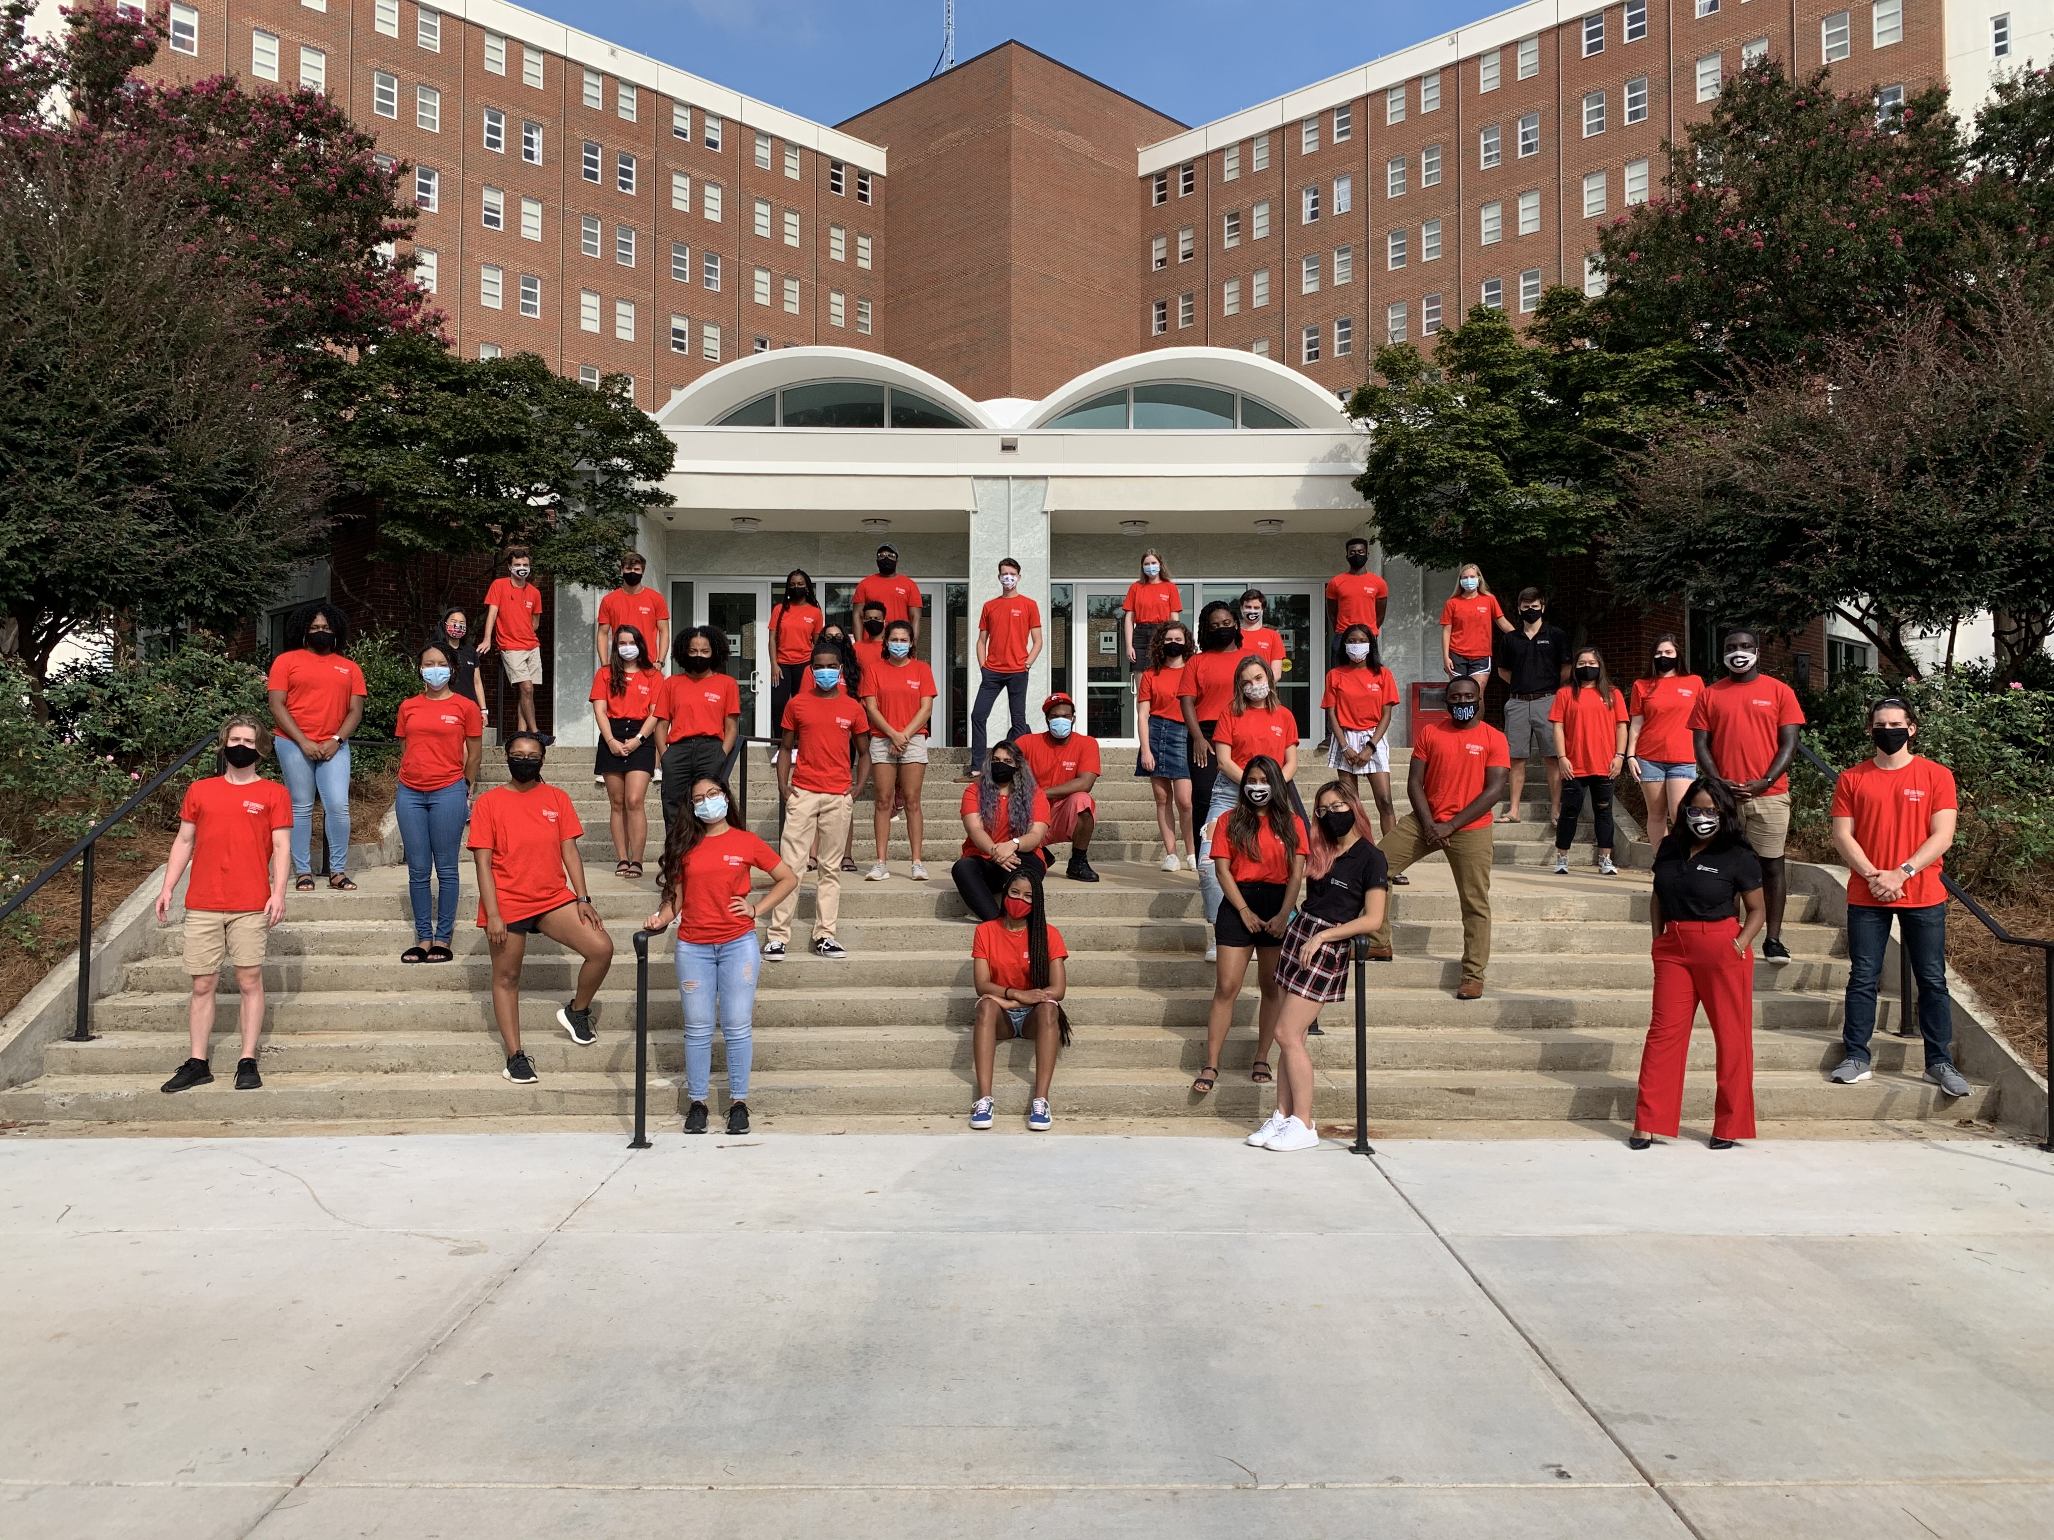
Application Review
Applications will be reviewed by our Residential Programs and Services (RPS) team.
Complete application -applications that are not complete are not passed to us by UGA jobs
2 Reference forms completed
In good standing (check student conduct)
GPA of at least 2.5
Completed one fulltime semester (12 hours)
www.housing.uga.edu

Slide 15
Applicants Notified
Friday, January 15, 2021 applicants are notified if they have been selected to interview.
Applicants will be directed to sign up for an interview time beginning on Friday, January 15, 2021 at 12 p.m. Applicants must sign up for an interview by Wednesday, January 20, 2021 at 12 p.m.
Our Employment Disclosure Form will be shared and applicants will need to acknowledge that they have read and understand the terms.
www.housing.uga.edu

Slide 16
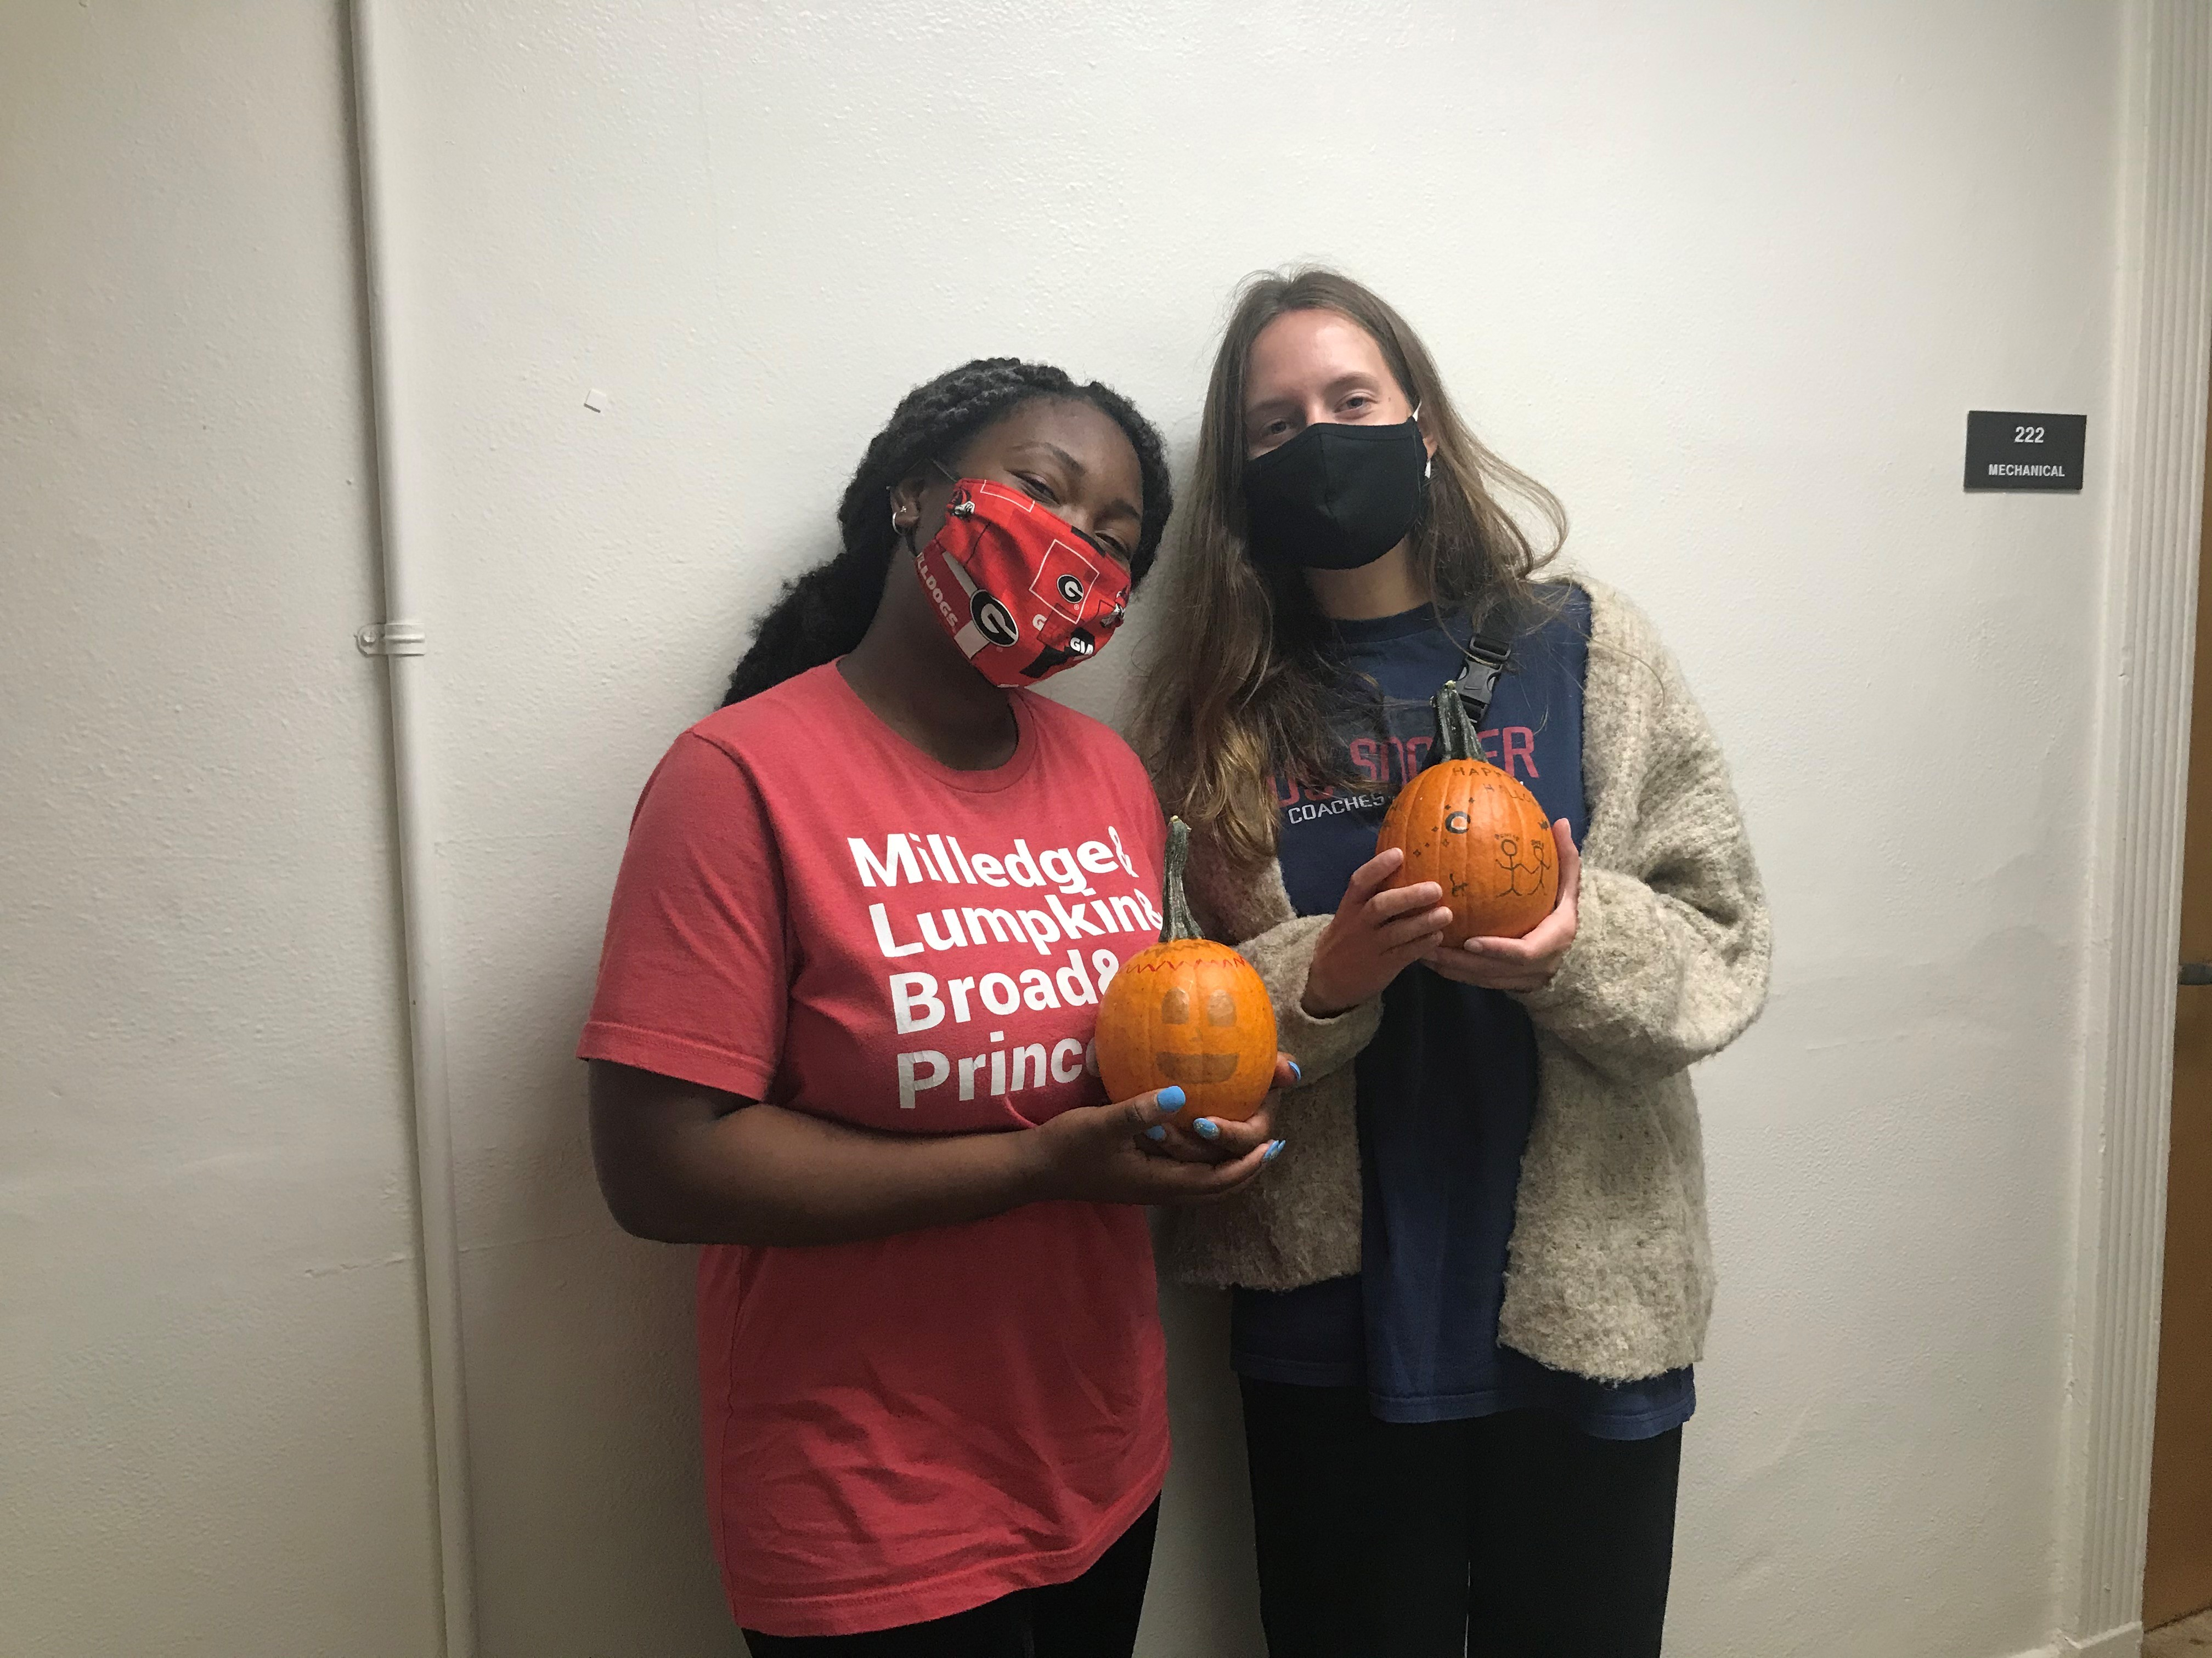
Disclosure of Employment Form
Complete 2 full time semesters (fall 2020 and spring 2021 (12 or more completed credits/semester)
Be a full-time student
Have and maintain a cumulative GPA of 2.50
Student conduct records are reviewed and any policy violations or failure to complete meetings and/or sanctions could impact candidacy for the CA or RA position
Successful completion of a background investigation
www.housing.uga.edu

Slide 17
Disclosure of Employment Form
May not hold any other assistantship, campus leadership position or other employment including work-study either within or outside UGA
Full academic year commitment
Cannot have current plans that could interrupt employment (i.e. mid-year graduation, study abroad, intentions to transfer universities, etc.)
Must obtain prior approval from supervisor for extracurricular activities and other time commitments
The CA-RA position is prioritized over other commitments except academics
www.housing.uga.edu

Slide 18
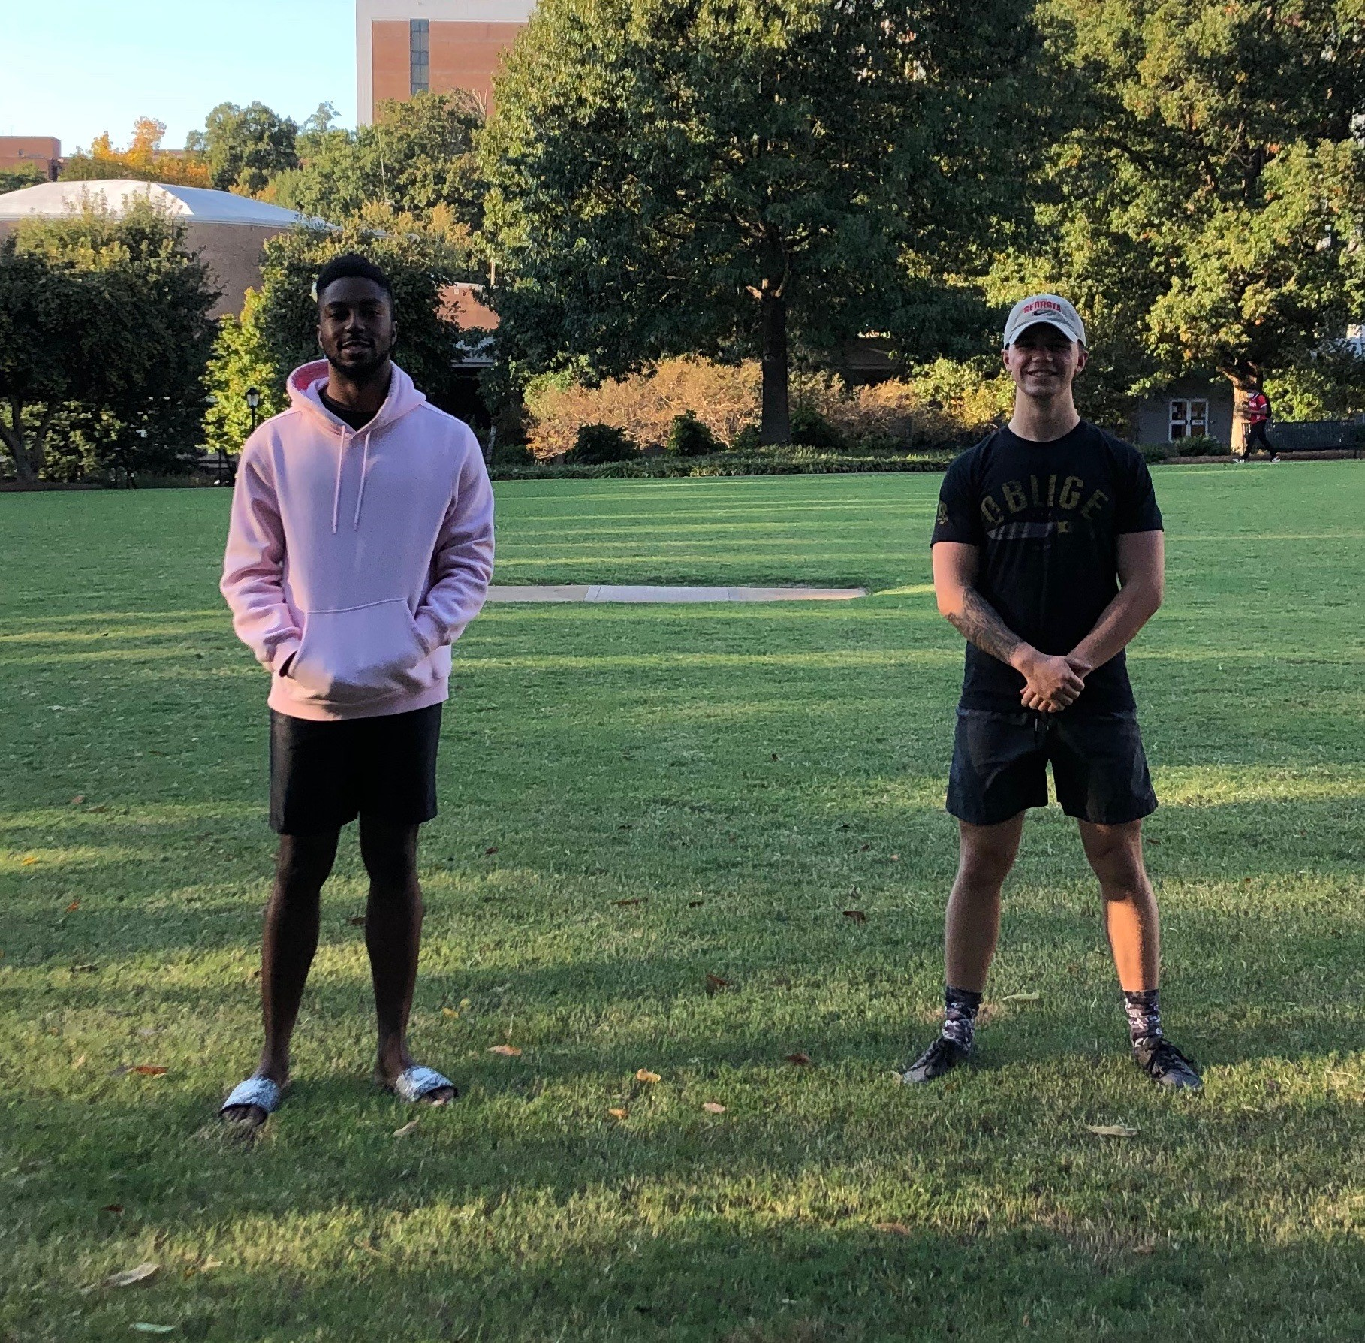
Disclosure of Employment Form
Non-traditional hours including weekend
and evening commitments
Supervisors may assign other related duties based on special circumstances, i.e. emergencies, crisis, staffing shortages, etc.
CA-RAs do not choose their community and/or building placement. The CA-RA staff are hired for University Housing, not a specific residential community
www.housing.uga.edu

Slide 19
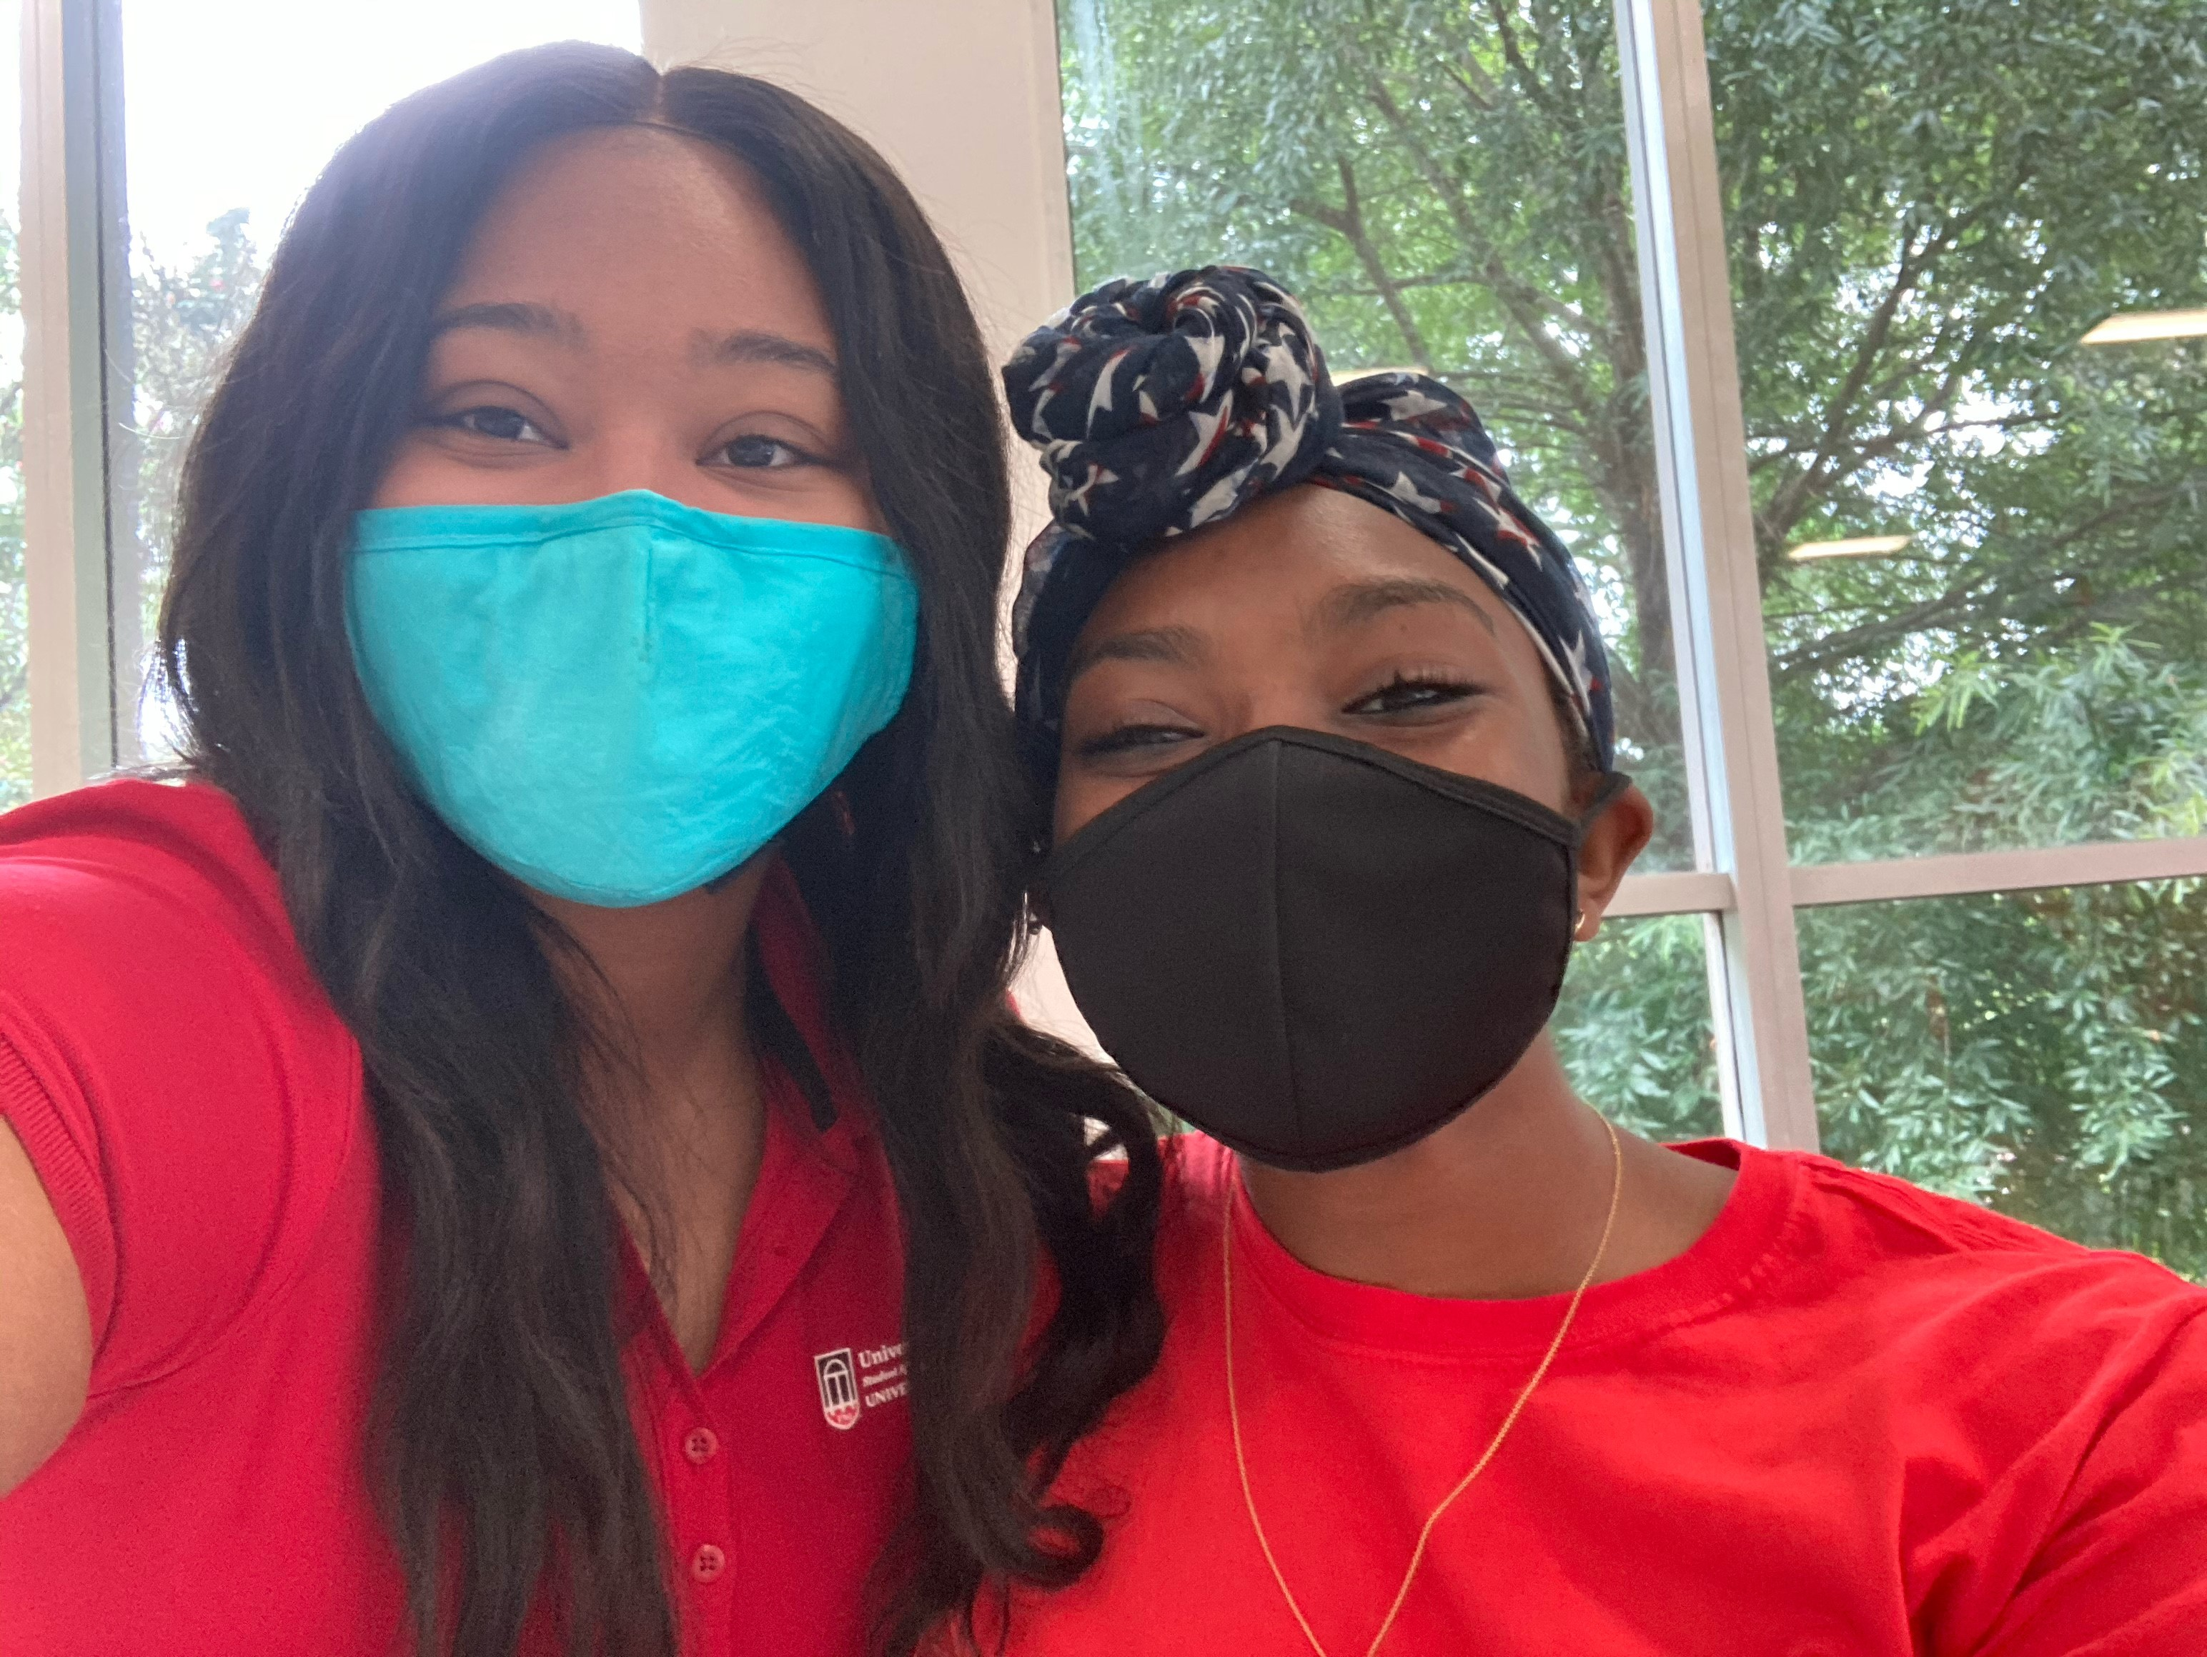
Disclosure of Employment Form
Return early from summer and breaks for fall, winter and online training
New CA-RA staff attend weekly training seminars in their first full semester of work
Weekly team meetings are held Wednesdays 8 p.m. – 10 p.m.
Support diversity awareness creating a culture of inclusion. Actively support all residents, promote inclusive programming and educate others about respect.
May not serve as a puppy raiser nor an alternate puppy raiser.
www.housing.uga.edu

Slide 20
Disclosure of Employment Form
CA-RAs are role models regarding alcohol and other drugs. Do not use alcohol if under the age of 21 and do not use illegal drugs or misuse legal drugs.
The CA-RA selection process is independent of the University Housing room sign-up process.
If you desire to live on campus next year, whether or not you are selected to be a CA or RA, you must follow instructions for returning resident room sign-up 2021.
If you are offered and accept a position, any funds paid for room sign-up are credited back to your student account.
If you are offered and decline a position or if you are not offered a position the room sign-up rules apply, and you will forfeit any funds paid if you decide to live off campus.
www.housing.uga.edu

Slide 21
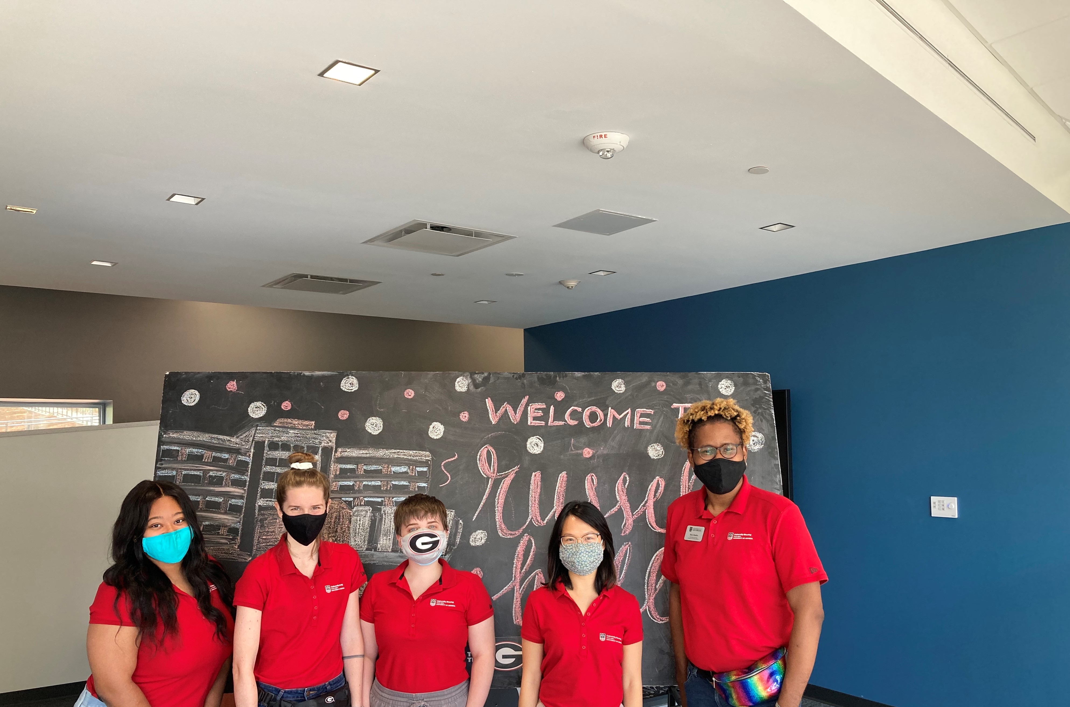
Individual Interviews
Held the 1st week in February 2021
CA interviews and RA interviews
are separate interviews.
2 RPS team members will interview each applicant.
Interviews are 30 minutes.
Interviews are currently scheduled to be held virtually.
If you are not present or are late to your selected interview, it will not be rescheduled.
www.housing.uga.edu

Slide 22
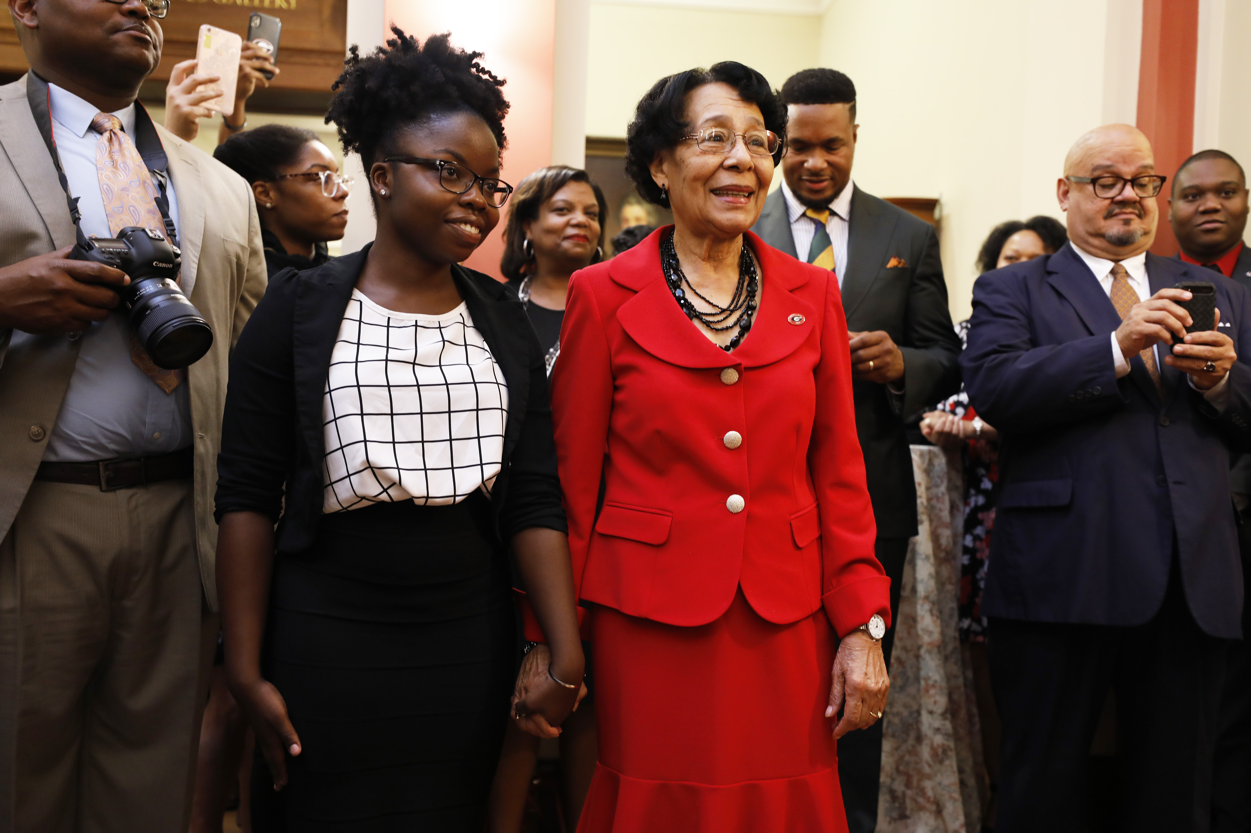
Tips for the Interview
Consider your setting for a virtual interview.
Make sure that the video and speakers are
working, and you can hear and be heard.
Appropriate attire
Research the position and university Housing:
Use your current CAs and/or RAs as a resource
Familiarize yourself with the position description
Have an understanding of University Housing’s mission
Know why you want the position
Know why you would be good for this position
Know what skills you can bring to the position
www.housing.uga.edu

Slide 23
Final Phase: Selection
Applicants will be sent an email on Tuesday, February 9, 2021 notifying them if they were selected as candidates for our final phase of selection.
Candidate applications will be reviewed and the UH team will make final decisions.
Decision emails sent on Tuesday, March 2, 2021.
Accept/Declines due on Monday, March 8, 2021.
Everyone selected as a CA and RA for Fall 2021 must attend Spring Orientation on Sunday, March 28, 2021 4 p.m. – 7:30 p.m.
www.housing.uga.edu

Slide 24
Other Important Information
Thrive CAs & RAs (Formerly Freshman College):
Mark on Disclosure of Employment Form if interested
Training begins late June 2021
Held in Russell Hall
Training held from 12 p.m. – 5 p.m. each day
If taking summer classes during1st session, they must be morning classes.
Fall training Tentative Dates: required for all staff
Training begins Monday, August 2, 2021 at 8 a.m.
Move in Sunday, August 1, 2021 2 - 5 p.m.
Please remember as you make summer plans!
www.housing.uga.edu

Slide 25
Questions? Want to contact us?
Kathryn Hall kchall@uga.edu
Glenda Wheatley gewheat@uga.edu
Clayton Lawing Clayton.Lawing@uga.edu
www.housing.uga.edu

